Slide 1
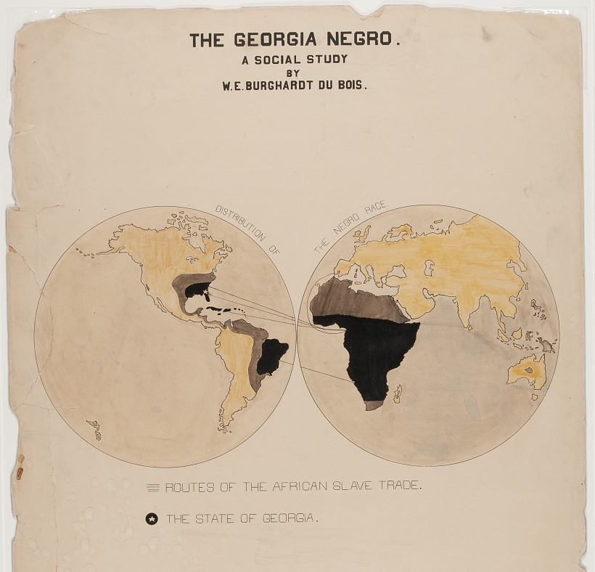
Color Line at the Turn of the Century Data Visualization from W.E.B. DuBois’s Paris Exhibition
DSE241 – Case Study
Alejandro Hohmann

Slide 2
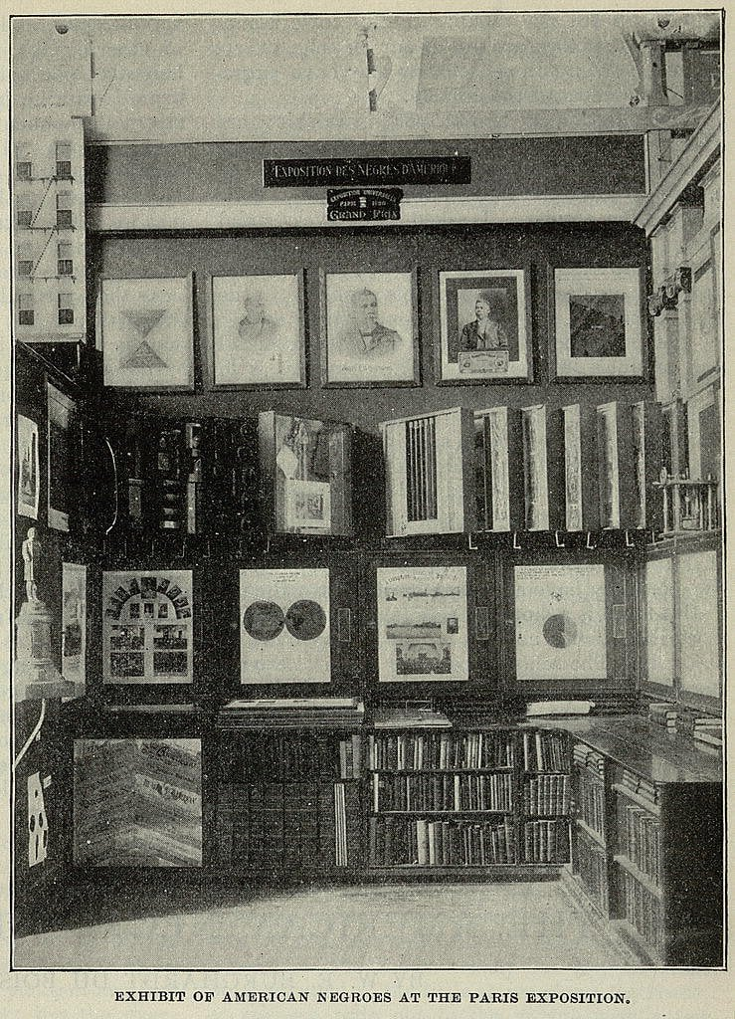
Background
The prolific sociologist and civil rights activist W.E.B. DuBois was asked to contribute to 1900 Paris World Expo.
Exhibit’s goal was “to educate patrons about the forms of education and uplift occurring at black institutions and in African American communities across the US South.” †
DuBois and a team from Atlanta University created 63 hand crafted charts (plates).
“Most of the information for the charts was drawn from sources such as the United States Census, the Atlanta University Reports, and various governmental reports that had been compiled by DuBois for groups such as the United States Bureau of Labor.” †
†W.E.B. DuBois’s Data Portraits, Visualizing Black America; pg. 9

Slide 3
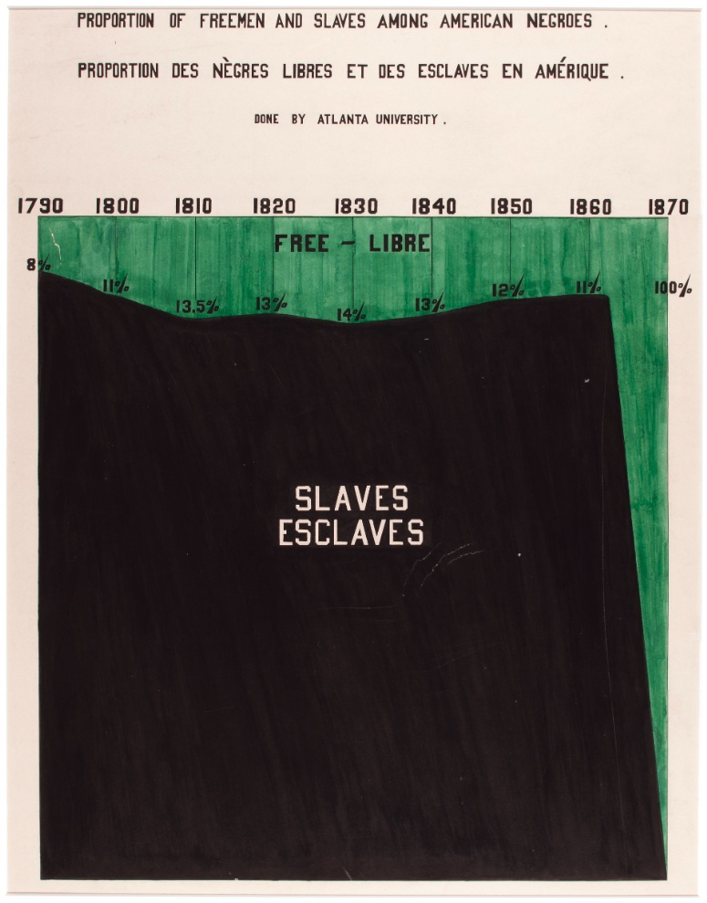
Plate 51
Idiom | 100% Stacked Area Chart
What: Data | Percentage of African Americans Free or Enslaved during 70-year period in USA
Why: Tasks | Proportion over time
How: Encode | Area marks Color channel for categorical attribute Length channel for time
Expressiveness & Effectiveness | Area chart perfect for proportion, especially in binary class. The vastness of the enslaved/black area highlights the scale of atrocity along with the stark contrast of 1870.
^{Image: Plate 51}

Slide 4
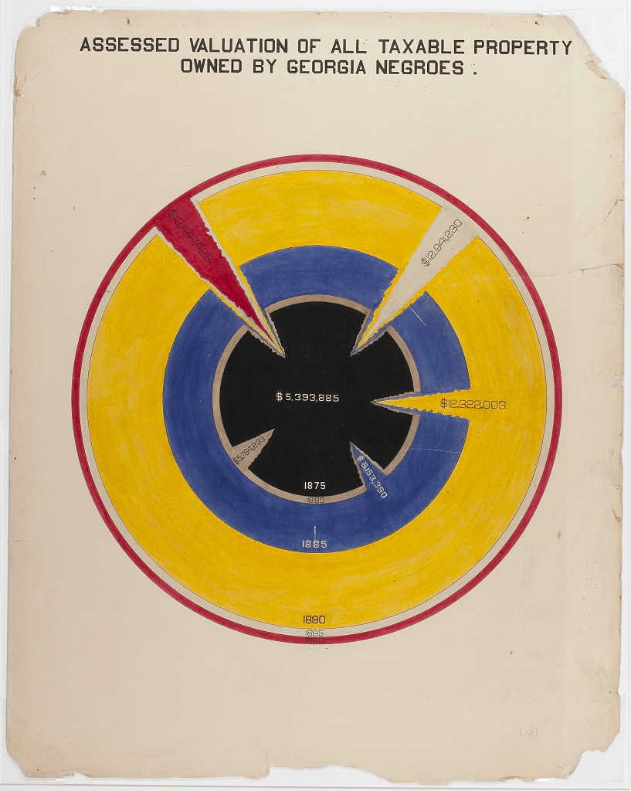
Plate 22
Idiom | Radial Pie Chart
What: Data | African American owned property values in Georgia during 40-year post-emancipation period
Why: Tasks | Value trend over time
How: Encode | Area channel for $ value Color channel for time period
Expressiveness & Effectiveness | Color channels clearly separate time-periods, but it is difficult to compare area, especially in this nested circular form.
^{Image: Plate 22}

Slide 5
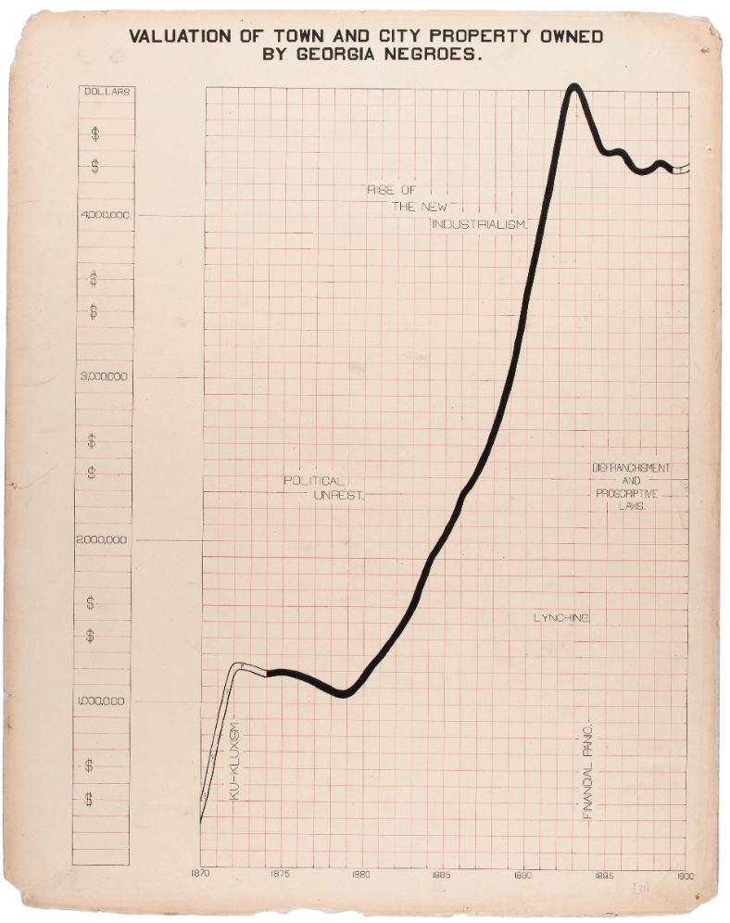
Plate 21
Idiom | Line Chart
What: Data | African American owned property values in Georgia during 40-year post-emancipation period
Why: Tasks | Value trend over time
How: Encode | Line marks Length channel for time Color channel for certainty/uncertainty Text annotation for context
Expressiveness & Effectiveness | The sharp ascent of a line highlights the quick progress made in the 40-year post emancipation period. The annotations highlight the tragic setbacks.
^{Image: Plate 21}

Slide 6
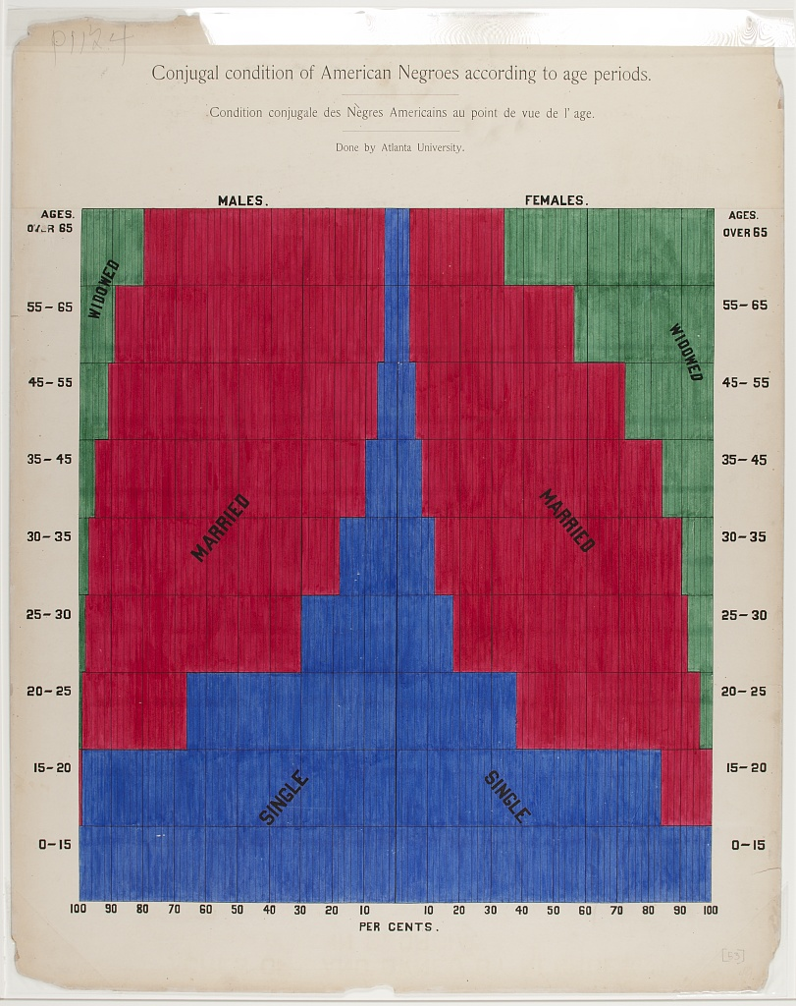
Plate 53
Idiom | 100% Stacked-Bar Mirror Chart
What: Data | Marriage Status across Genders and Age
Why: Tasks | Compare proportions across multiple categories
How: Encode | Spatial channel for gender Color channel for marriage status Area/Length channel for proportion
Expressiveness & Effectiveness | Color channels clearly indicate marriage status and vertical axis does a nice job of showing change across ages. It can be somewhat difficult to compare diverging lengths (gender) but aided by percent labels on horizontal axis.
^{Image: Plate 53}

Slide 7



Contact
Reference & Source
Primary Reference: W.E.B. DuBois’s Data Portraits, Visualizing Black America; Whitney Battle-Baptiste, Britt Rusert
Image Source:
https://github.com/ajstarks/dubois-data-portraits
Modern, digital recreations of the original portraits
Alejandro Hohmann
ahohmann@ucsd.edu
github.com/gojandrooo

